Slide 1
Docker

Slide 2
Docker containers are NOT VMs
Easy connection to make
Fundamentally different architectures
Fundamentally different benefits
Notes:
This is completely understandable, and many people have done the exact same thing when they first started working with Docker. It’s easy to connect those dots as both technologies share some characteristics. Both are designed to provide an isolated environment in which to run an application. Additionally, in both cases that environment is represented as a binary artifact that can be moved between hosts. There may be other similarities, but to these are the two biggest.
The key is that the underlying architecture is fundamentally different between the containers and virtual machines. The analogy we use here at Docker is comparing houses (virtual machines) to apartment buildings (Docker containers).

Slide 3

VMs
Notes:
Houses (the VMs) are fully self-contained and offer protection from unwanted guests. They also each possess their own infrastructure – plumbing, heating, electrical, etc. Furthermore, in the vast majority of cases houses are all going to have at a minimum a bedroom, living area, bathroom, and kitchen. It’s incredibly difficult to ever find a “studio house” – even if one buys the smallest house they can find, they may end up buying more than they need because that’s just how houses are built.
VMs are a full copy of an operating system with it’s own dedicated resources. If you decide you need a new house, you build a whole new house – it’s own foundation, plumbing etc. if you want a new VM you deploy a full copy of that environment – the OS, the apps, everything. VMs stand alone, and the leads to duplicating resources – every instance has it’s own full copy of the OS, for instance. Finally the smallest VMs are typically at least hundreds of MBs in size, and they take several minutes to boot up (partially due to the fact that you’re starting a full copy of the OS).

Slide 4
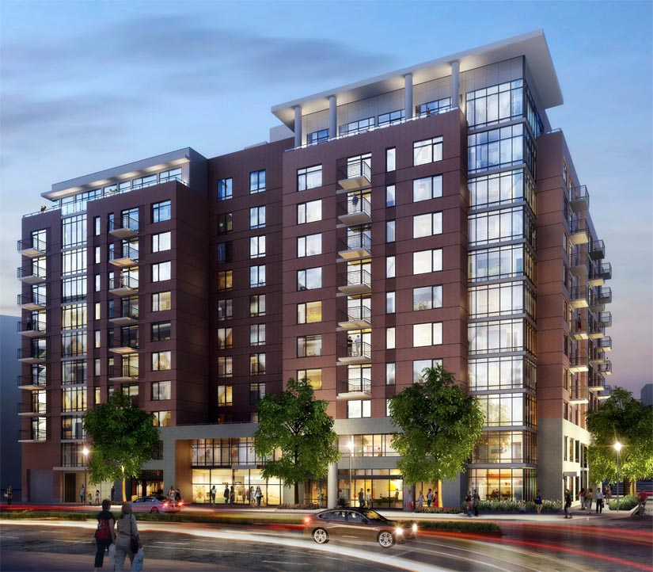
Containers
Notes:
Apartments (Docker containers) also offer protection from unwanted guests, but they are built around shared infrastructure. The apartment building (the server running the Docker daemon, otherwise known as a Docker host) offers shared plumbing, heating, electrical, etc. to each apartment. Additionally apartments are offered in several different sizes – from studio to multi-bedroom penthouse. You’re only renting exactly what you need.
Docker containers share the underlying resources of the Docker host. Furthermore, developers build a Docker image that includes exactly what they need to run their application: starting with the basics and adding in only what is needed by the application. Containers are very small (some base OS images are less than 3MBs) start up very quickly (< 3/8s of a second) because you’re not booting a full operating system. You’re just starting a process.

Slide 5
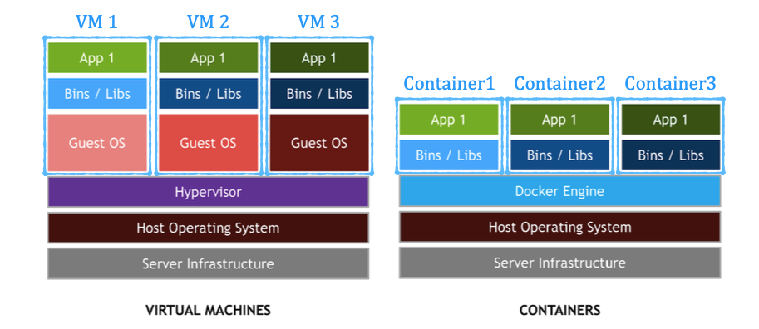
Docker is similar (in spirit) to Virtual Environments but at a File System level

Slide 6
Variables to Consider
Performance
Security
Scalability
Existing Skillsets
Costs
Etc.
http://people-equation.com/do-your-words-encourage-or-deflate/math-equation_chalkboard/

Slide 7
Container Consolidation Testing
How can containers help organizations optimize hardware utilization?
Testing done by HPE, Docker and Industry Consultant
Components:
Docker CS Engine 1.12.3
VMware ESXi 6
SysBench 1.0 (Nov 2016)
RHEL 7.2
HPE ProLiant DL360 Gen 9 servers with HPE 3PAR StorServ 8200 SSD Storage
Notes:
Docker and HPE have worked with industry consultant Bret Fisher to drill down a bit more deeply into how migrating from running a workload in multiple VMs to a multiple containers in a single VM affects performance.
The test, which uses the SysBench benchmark, was run on HPE Proliant servers w/ 3Par storage. And used Docker CS (commercially supported) Engine 1.12.3 and VMware ESXi 6. Bret used RHEL 7.2 as the host platform whenever a kernel was needed.

Slide 8
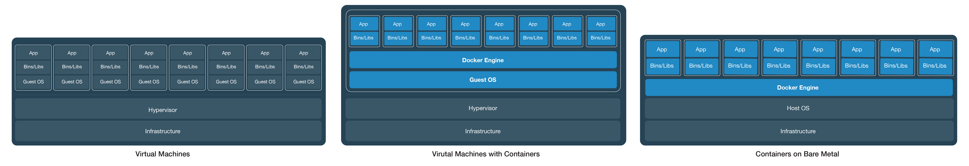
Testing Scenarios
Need to replace this graphic w/ the one w/ 8 boxes
Measure SysBench performance across 3 configurations
Scenario 1: 8 VMs
Scenario 2: 1 VM w/ 8 Containers
Scenario 3: 8 Containers on Bare Metal
Notes:
For this testing we used SysBench to measure database performance. SysBench reports back “Transactions per second”. The testing was designed to see how moving from VMs to Containers would affect SysBench performance.
Initially 8 instances of SysBench were run in 8 separate VMs, and a baseline measurement was taken.
Next a single VM was built that used the same total resources as the 8 VMs used in the first phase. SysBench was then run inside of 8 different containers on that host.
Finally, in the final phase the 8 containerized benchmarks were run on bare metal (meaning the containers were hosted on a Linux OS installed natively on the server).
The test was designed under the following constraints:
The number of workload instances (in VMs for test S1 and in containers for S2 and S3) should be the same when doing comparisons (e.g. 8 vms vs 8 containers of similar sizes).
The hosts used for each test case should be identically configured using the same hardware, BIOS, and Firmware. This was assured utilizing the same HPE OneView server profile template for the 3 identical HPE ProLiant DL360 servers utilized in the testing
The sum of the CPU, Memory, and Storage throughput provided to each test case should be the same. For example the single large VM had the same total CPUs and RAM as were consumed by the 8 VMs in Scenario 1
Proper scheduling and resource constraints should be applied to both containers and virtual machine to keep the CPU and memory available to each instance of the workload the same regardless of test scenario.

Slide 9
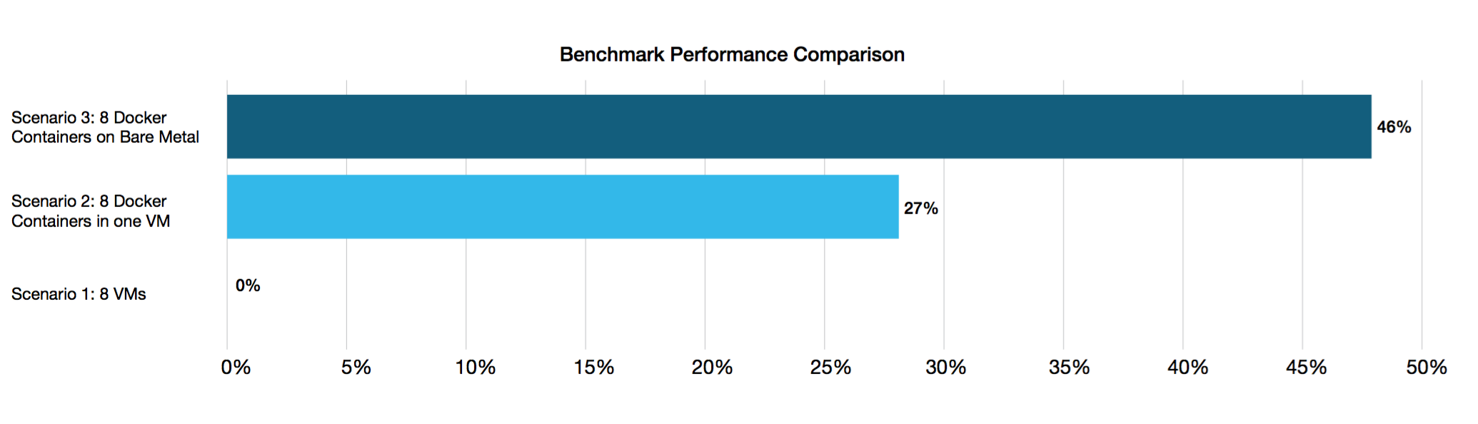
Results
Moving from VMs to containers increases performance 27% to 46%
Results are after VM and Container Tuning
Notes:
The benchmark was CPU intensive, and is probably representative of an application that would benefit less from being placed in a container than say an application that was memory or storage bound. Because of this we feel that the results we gathered represent a conservative estimate of the benefits of consolidating workloads inside of containers.
When the dust settled we found that the benchmark showed a 27% performance improvement when run in multiple containers in a single VM. And, when moved to bare metal, there was a 46% improvement.
Both of these results were after we tuned the VM host to leverage CPU affinity and pinning.

Slide 10
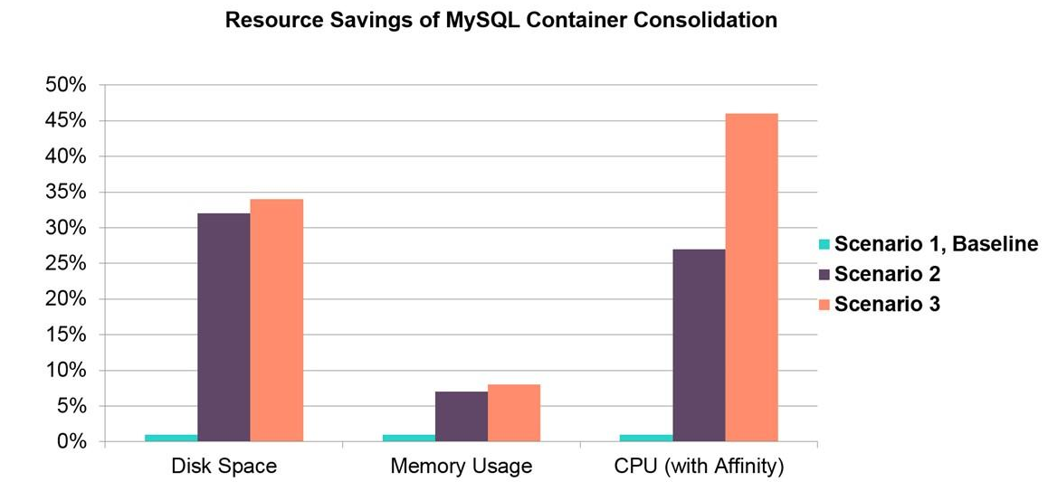
Additional Savings
Docker allowed for savings in memory and disk as well
Notes:
This chart shows the % of savings in terms of storage consumption and memory usage (it also reiterates the CPU savings discussed on the last slide).
Disk space savings across S2 and S3 came from multiple factors, and are compared to the baseline totals needed for S1, including 9GB of databases and indexes per VM, and reserved space for growth and backups. These values aren’t meant as a guideline, but rather a view into the various ways that consolidation and containers can save resources.
Areas we saw significant disk savings include:
Fewer VM’s with OS overhead. A bare RHEL vmdk without databases or indexes was about 8GB (thin provisioned), in S2 and S3 we reduced the Linux OS count VM count from 8 to 1.
Docker images are single instance storage.
In S2 and S3, our MySQL containers shared the same base image (400MB MySQL Official Image) and thus containers only need space for databases and indexes, saving us 2.7GB.
VMware ESXi needs a minimum 5GB to install, so we’ll consider that a savings on S3.
Tip
As the majority of the above savings is per VM, with items 1 and 2 combining to roughly 8.4 GB per VM consolidated, the disk space savings is proportional to how many VMs are being consolidated. For well-defined workloads similar logic to the above can be employed to calculate disk space savings.
Memory savings across S2 and S3 came from several factors, and we use percentages above compared to the total 256GB in each host:
The removal of VM’s running a standard RHEL config, which we averaged at 1.5GB savings per workload.
VMware requires memory overhead for each VM running with reserved memory, saving us 1GB per VM removed.
We reserved 1GB of memory for the ESXi host, which we eliminated in S3.
Tip
Similar to disk space savings, items 1 and 2 above are also per VM savings and combined to a savings of roughly 2.5 GB memory saved per VM removed. For well-defined workloads similar logic to the above can be employed to calculate memory utilization savings.
Any reason we don't want to call out the % in text?
is there a reason we don't show the % here

Slide 11
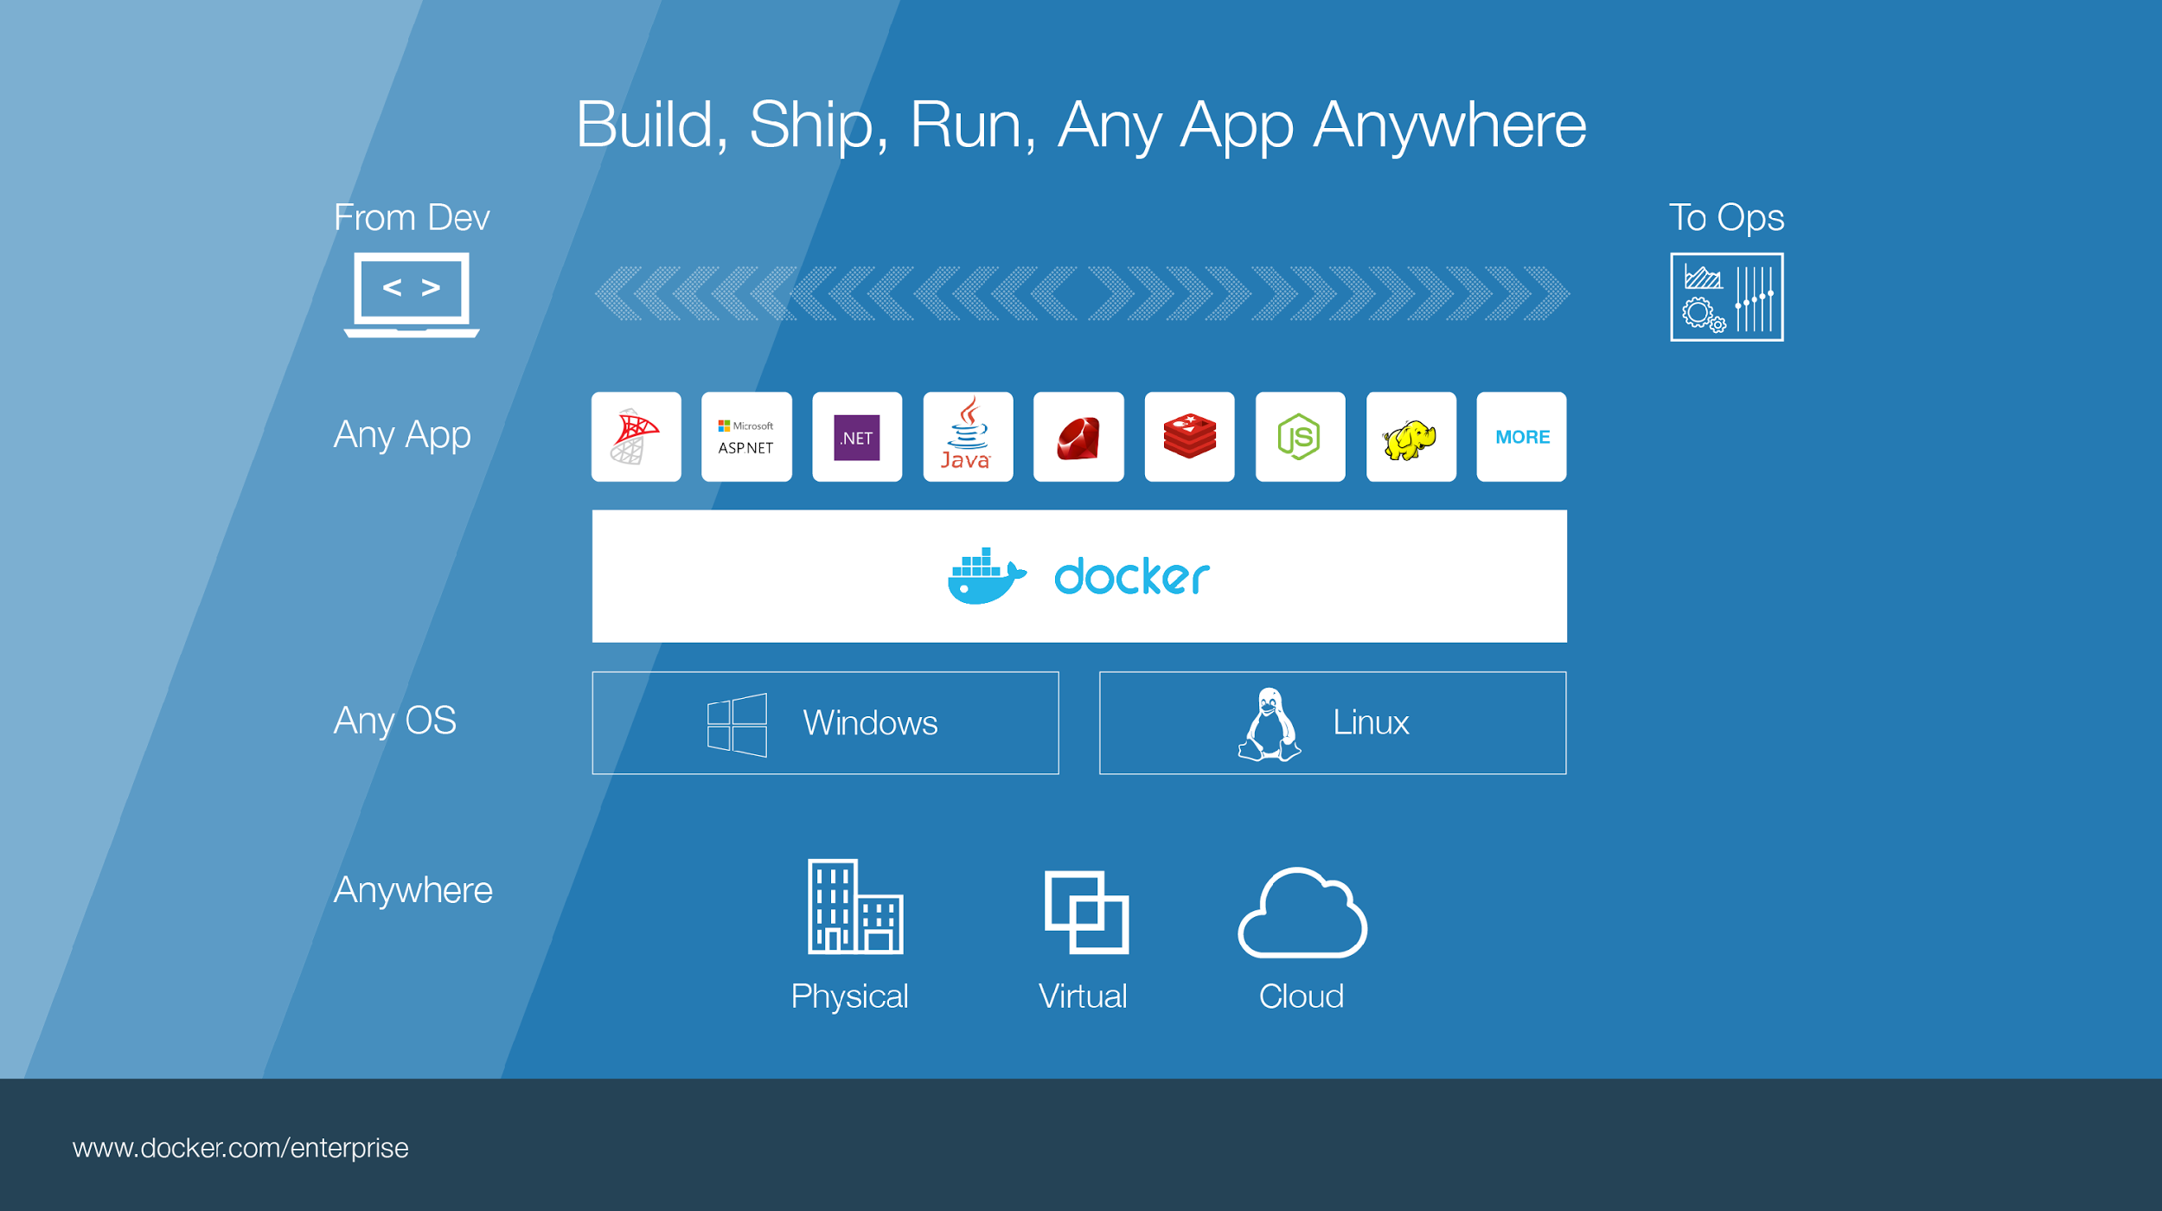
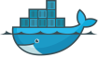
Notes:
Build, Ship, Run – Any App Anywhere – that’s Docker’s slogan
But, what does it mean?
What it essentially boils down to is that developers can choose whatever language or components they want to build their application – .Net, ASP, Java, Ruby, Redis, etc across both the Linux and Windows ecosystem. They are assured that whatever the code up, will run wherever the Ops team chooses to deploy it – Physical, virtual, or cloud – it makes no difference to Docker.
An application written on a developers laptop will run exactly the same on the largest bare metal servers, in the cloud, even on a Raspberry Pi in my den.
Move applications seamlessly from dev to test to production.

Slide 12
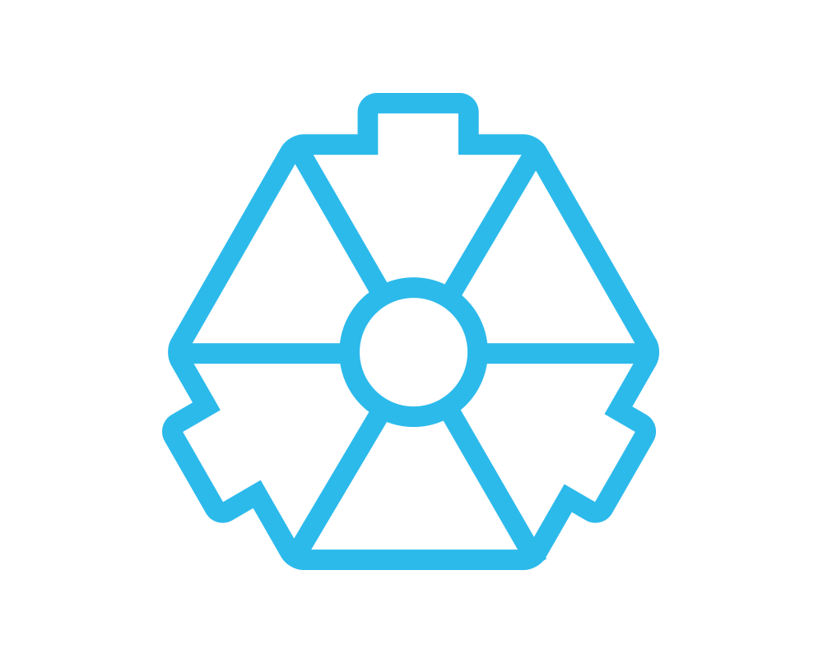
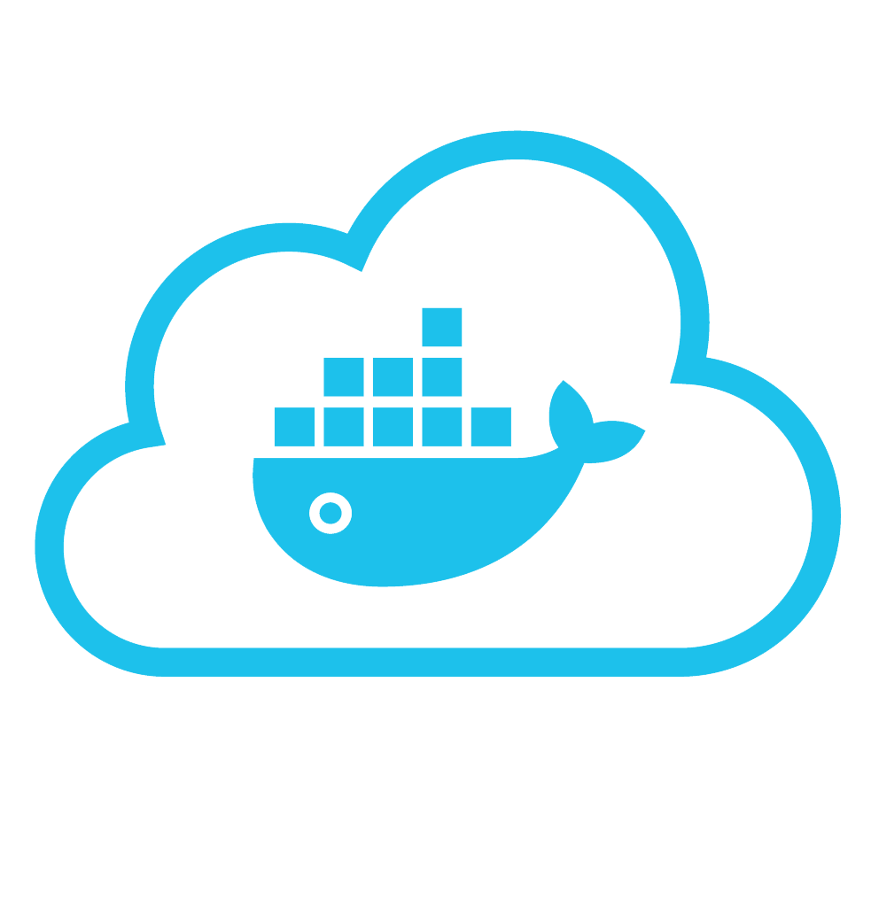
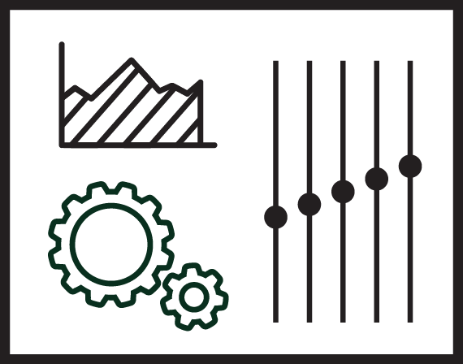


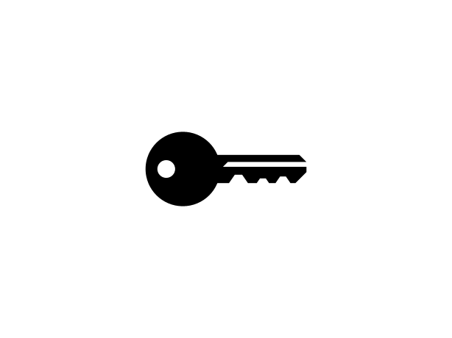
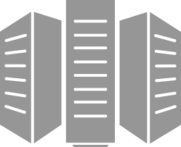
Put it all together: Build, Ship, Run Workflow
Developers
IT Operations
BUILD
Development Environments
SHIP
Create & Store Images
RUN
Deploy, Manage, Scale
Notes:
Local development environments
Self service app images
Build, Test, Deploy applications
Define app behavior and infra needs
Registry services for image storage, management and distribution
IT Ops maintains library of secure base content
Manage role based access to repos/images
Management consoles
Provision, manage infrastructure resources
Monitor, manage, scale infrastructure and applications

Slide 13




Some Docker vocabulary
Docker Image
The basis of a Docker container. Represents a full application
Docker Container
The standard unit in which the application service resides and executes
Docker Engine
Creates, ships and runs Docker containers deployable on a physical or virtual, host locally, in a datacenter or cloud service provider
Registry Service (Docker Hub or Docker Trusted Registry)
Cloud or server based storage and distribution service for your images
Notes:
Let’s take a look at what build, ship run means in a little more detail, but before that we need to level set some Docker vocabulary and commands:
Image
The static component that represents a on-running application
Containers are derived from images
images contain EVERYTHING an application needs to run
Should always be built via a Dockerfile (which we’ll talk about in a bit_
Container
The standard unit in which the application service resides
Package app and dependencies together
Isolated from other containers
One container per app / service
Docker Engine
The program that creates, ships and runs containers
Deployable on any physical or vm host locally, in datacenters or cloud
Communicates with Docker Hub
Registry
The service that store, distributes and manages container images
Receives commands from Docker Client via Engine
Access control with public, private repos

Slide 14
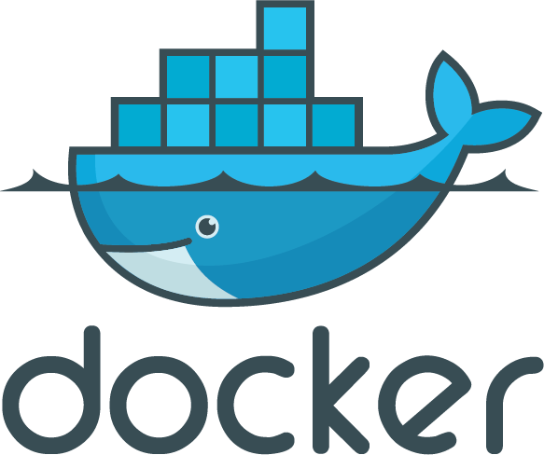
Enterprises are looking to Docker for critical transformations
3 out 4
Top initiatives revolve around applications
App Modernization
80%
Docker is central to cloud strategy
44%
Looking to adopt DevOps
Cloud
DevOps
Docker Survey: State of App development : Q1 - 2016
State of App development Survey: Q1 2016
Notes:
So why do companies look at Docker?
Software is the lifeblood of your organization, whether automating internal processes or creating unique and engaging ways for you to service your customer, every company considers themselves a “digital” or “tech” company to some extent. To that end, many organizations like yours are looking at strategies to…
- Modernize their apps (refactor or build cloud native apps)
- Adopt microservces / distributed app architectures
- migrate to containers
- Cloud adoption, migration or multi cloud approaches
But getting tthere isn’t always easy becuase you have legacy applications and envrionment to take care while you try to do new innovatinv things. Your organizational processes might not be ready to go all in and how do you avoid the worries of just getting locked into a cloud from your datacenter?

Slide 15
Docker delivers speed, flexibility and savings
+
+
Agility
Portability
Control
13X
More software releases
41%
Move workloads across private/public clouds
62%
Report reduction in MTTR
65%
Reduction in developer onboarding time
10X
Cost reduction in maintaining existing applications
Eliminate
“works on my machine” issues
State of App development Survey: Q1 2016, Cornell University case study
Notes:
The Docker CaaS platform delivers these benefits for organizations and is already proven by the thousands of organizations who embarked on the Docker journey starting in 2013
Agility – The speed and simplicity of Docker is what originally drew developers to Docker. They were fundamentally able to ship more software faster. This fundamentally changed the way in which companies could innovate
- ING went from shipping once every 9 months to shipping over 1,500 times a year by adoption Docker and DevOps
- CapitalOne was able to use Docker to transform how they use data to empower their data scientists and business decisions.
Portability – Just by the nature of the Docker technology, these developers realized they could easily move that containerized app from dev to test and ultimately to prod without any issue. No more finger pointing about why the app that worked fine in dev doesn’t work in prod. Having the app and dependencies packaged together made the container a self contained and independent unit. And beyond that, teams realized they could also move these apps across data centers and clouds – giving them a level of freedom and leverage not possible before. No more lock-in.
The combination of agility and portability led to the #1 most popular use case for Docker – Continuous Integration. But that’s only half the value. To realize the full value of Docker, these apps need to move to production and new requirements around manageability, security and monitoring are required to enforce SLAs.
Control – The Docker platform is the only solution that provides Agility AND Portability AND Control.
Docker standardizes your application environment, with native tooling to manage the infrastructure and applications. And we provide you the levers so YOU can decide how much control and freedom is appropriate for YOUR business. We don’t prescribe that for you. Our tools help unify your heterogeneous infrastructure, languages and systems.

Slide 16
Basic Docker Commands
$ docker pull redis – pulls latest redis image from dockerhub
$ docker images – lists images available on your local docker host $ docker run –d -–name test-redis redis – create container in detached mode (running in the background) and –-name test redis specifies the name of our running container
$ docker ps – lists all running containers $ docker stop test-redis (or <container id>) - stops a running container
$ docker rm test-redis (or <container id>) – removes stopped container
$ docker rmi redis (or <image id>) - removes specified image
Notes:
Docker pull pulls an image from the registry to the local host. This example shows us pulling latest redis image on Docker Hub
Docker images will list all the images on your docker host
Docker run will start a new container. In this case we are instructing the docker engine to run the redis image we pulled earlier -d tells docker It should start the application in detached mode (running in the background) –name test-redis specifies a name for our running container. If you do not specify a name, Docker will generate one (and they can be pretty funny)
Docker ps shows runing containers. ps –a will show all containers, including ones that have been stopped
Docker stop stops a running container (but does not delete it). You can specify the container name (test-redis in our example) or the container ID (every image and container are assigned a unique ID)
Docker rm removes the stopped container. if you specify rm –f you will force docker to remove container even if it’s running. again you can specify the name or ID
Docker rmi removes the specified image

Slide 17
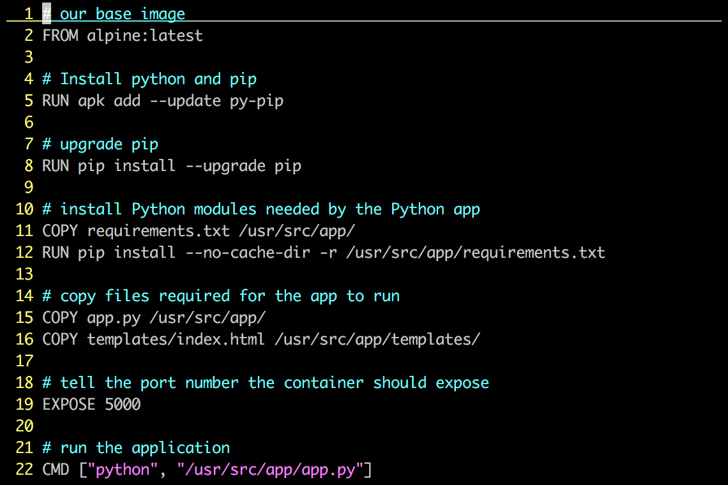
Dockerfile – Linux Example
Instructions on how to build a Docker image
Looks very similar to “native” commands
Important to optimize your Dockerfile
Notes:
A Dockerfile describes how to build a docker image (using the ‘docker build’ command). The commands in the file are a mix of commands you’d actually run to install an application locally (in this case we’re building a python app, and if you’re familiar with Python, you’ll instantly recognize much of what is up on the screen) and specific keywords that tell Docker what to do (RUN a command COPY a file, etc).
An important point about Dockefiles is that they can live with your source code, and be versioned by your version control system. This means Docker images are 100% reproducible. This is another area where VMs and Containers can be different – many times VMs are hand built, and if you lose your golden image you’re out of luck.
This Dockerfile builds a simple flask-based python webapp.
Let’s step through the Dockerfile line by line – note that when the Docker file is processed, all these commands are being run on the Docker image – not your local machine.
Line 1: Build this new Docker image based on the official Apline Linux base image
Line 5: Install Pythong and Pip (the python package manager)
Line 7: use Pip to ensure that Pip is the latest version
Line 11: Requirements.txt holds a list of libraries the app will need, and is used by pip to actually install the library. This line copies the file from your local machine into your Docker image
Line 12: Uses that file and Pip to install the requirements into the container
Line 15: Copy my application code (app.py) into the /usr/src/app directory of the image
Line 16: Copy our index.html file into the /usr/src/app/templates directory of the image
Line 19: The application communicates on port 5000, so we tell Docker to listen on that Port
Line 22: When the container starts up – we fire up Python and pass it out application code to start the app
Again, these steps are pretty much EXACTLY what you would do on a traditional machine to run this application, only here there are being used to create an Docker image.

Slide 18
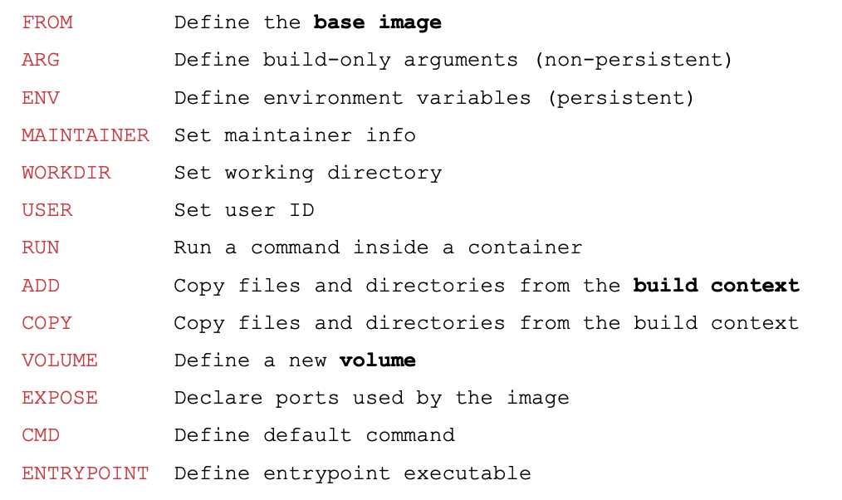
Dockerfile - Instructions
Useful documentation: docs.docker.com/reference

Slide 19
Dockerfile vs Docker Compose
Use a Dockerfile when you need to create a custom image for your application, and you want to automate the process of building that image.
Use Docker Compose when you have an application that requires multiple services, and you want to manage them as a single entity.
It’s worth noting that Dockerfile and Docker Compose can be used together in more complex scenarios where you need to build custom images for each service in your application and manage them as a group.

Slide 20
Kubernetes
What is Kubernetes?
Kubernetes is an open source orchestration tool developed by Google for managing micro- services or containerized applications across a distributed cluster of nodes.
Kubernetes provides highly resilient infrastructure with zero downtime deployment capabilities, automatic rollback, scaling, and self-healing of containers (which consists of auto-placement, auto-restart, auto-replication, and scaling of containers on the basis of CPU usage).
Kubernetes created from Borg & Omega projects by google as they use it to orchestrate they data center since 2003.
Google open-sourced kubernetes at 2014.

Slide 21
What Orchestration Do?
Configuring and scheduling of containers.
Provisioning and deployments of containers.
High Availability of containers.
Configuration of the applications that run in containers.
Scaling of containers to equally balance the application workloads across infrastructure.
Allocation of HW resources between containers.
Load balancing, traffic routing and service discovery of containers.
Health monitoring of containers.
Securing the interactions between containers.

Slide 22
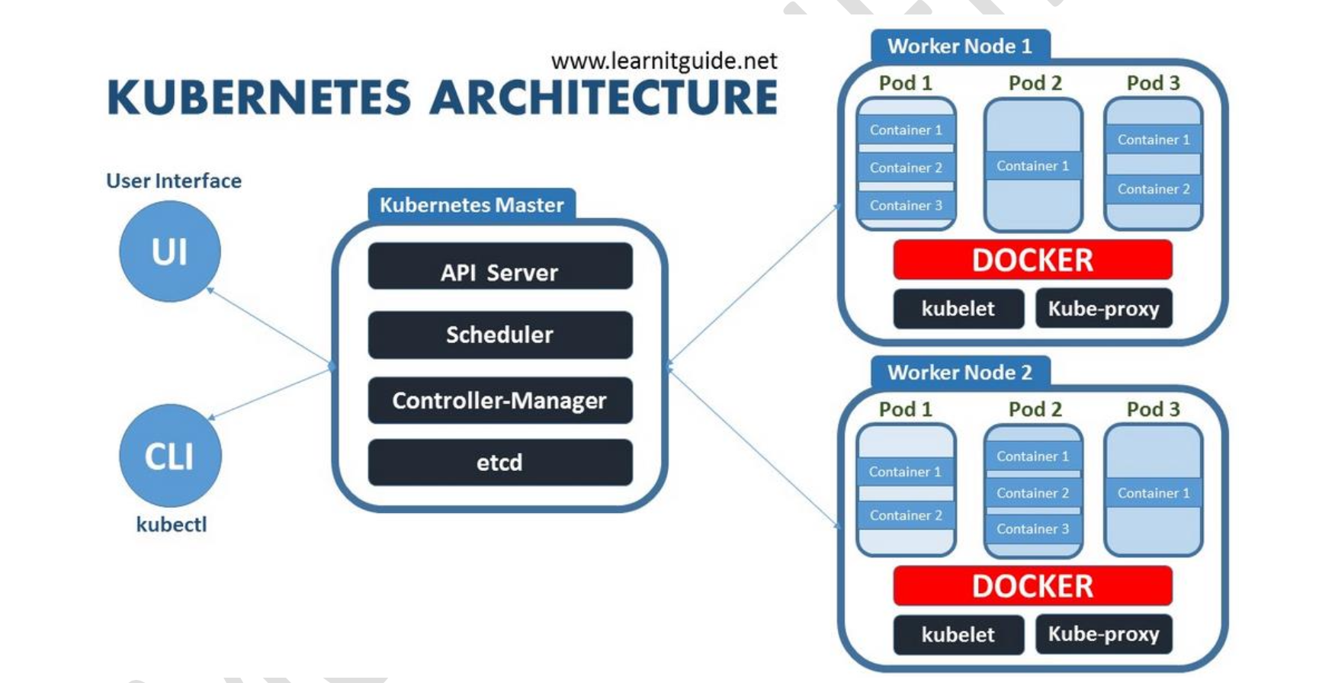
Container Orchestrator
Docker Swarm
Mesos (Mesos Sphere)
Normand
Cloud Foundry
Cattel
Cloud (Azure, Amazon, Google, Alibaba, IBM)
Kubernetes Components and Architecture
8s Master Node: the master server that will create the cluster and it has all the components and service that manage, plan, schedule and monitor all the worker nodes.
Worker Node: the server that has host the applications as Pods and containers.
Can make more than master server to make HA for the K8s components

